Slide 1
MUSCLE MENTOR
WORKOUT CORRECTOR

Slide 2
INTRODUCTION
The project focuses on creating a system to help users perform gym exercises correctly by using real-time feedback.
Using computer vision and machine learning, the system identifies and corrects improper exercise form to prevent injuries and improve efficiency.
The project covers multiple exercises such as bicep curls, shoulder presses, and squats.
The interface is developed using Streamlit and includes a voice assistant for hands-free guidance.

Slide 3
PROBLEM DEFINITION
Many gym-goers, especially beginners, struggle with maintaining proper form during workouts.
Incorrect exercise form can lead to injuries and reduced workout efficiency.
Lack of personalized guidance in real-time makes it difficult to detect mistakes during exercise.

Slide 4
⁠OBJECTIVE
Develop a system that provides real-time feedback on exercise form using computer vision.
Utilize MediaPipe and OpenCV to track body posture and joint angles.
Create an easy-to-use interface with Streamlit and integrate voice assistance for real-time feedback and guidance.
Track multiple exercises, including bicep curls, shoulder presses, and squats.

Slide 5
SURVEY / IDEAS
Analyzed existing fitness apps and tools that use sensors or camera-based tracking to correct form.
Identified the limitations of current systems, such as the lack of real-time feedback or the need for additional hardware (e.g., wearable devices).
Explored how machine learning can enhance form correction by training models on proper and improper exercise forms.
Chose MediaPipe and OpenCV for their efficient posture tracking capabilities.

Slide 6
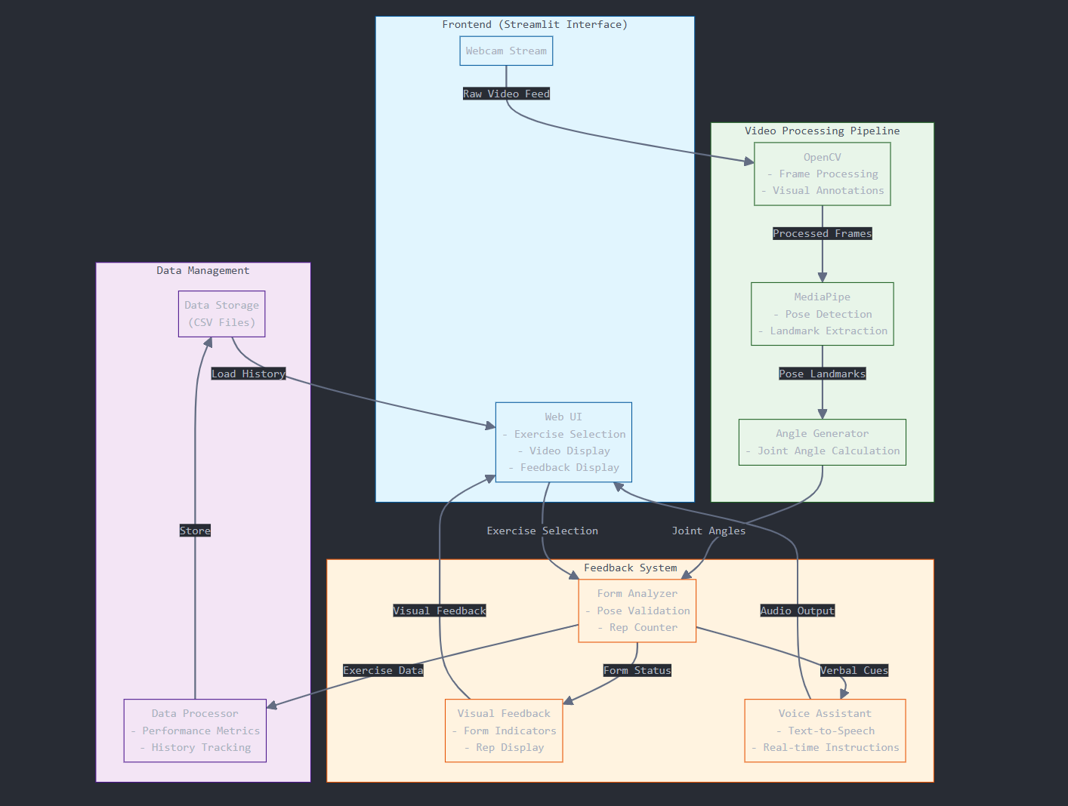
SYSTEM ARCHITECTURE

Slide 7
DETAILED DESIGN
Pose Estimation: MediaPipe is used for real-time human pose detection. The model detects key points (like shoulder, elbow, and wrist) to calculate angles.
Form Correction Algorithm: The program uses predefined angle thresholds for each exercise. For example, if the angle between the elbow and wrist exceeds a certain limit in a bicep curl, the form is flagged as incorrect.
Voice Assistant: A text-to-speech system is integrated to provide users with verbal feedback, instructing them to correct their form or congratulating them when correct.
Streamlit Interface: Streamlit is used to create a user-friendly interface where the user can select exercises, view real-time posture tracking, and receive visual and auditory feedback.

Slide 8
⁠TOOLS AND TECHNOLOGIES USED
MediaPipe: Used for detecting and tracking human body landmarks in real time.
OpenCV: Image processing library used for analyzing the video feed and calculating joint angles.
Streamlit: Framework for creating the web interface, allowing users to interact with the system.
Python: Primary programming language for developing the system.
Text-to-Speech Library: For implementing the voice assistant to provide real-time feedback.

Slide 9
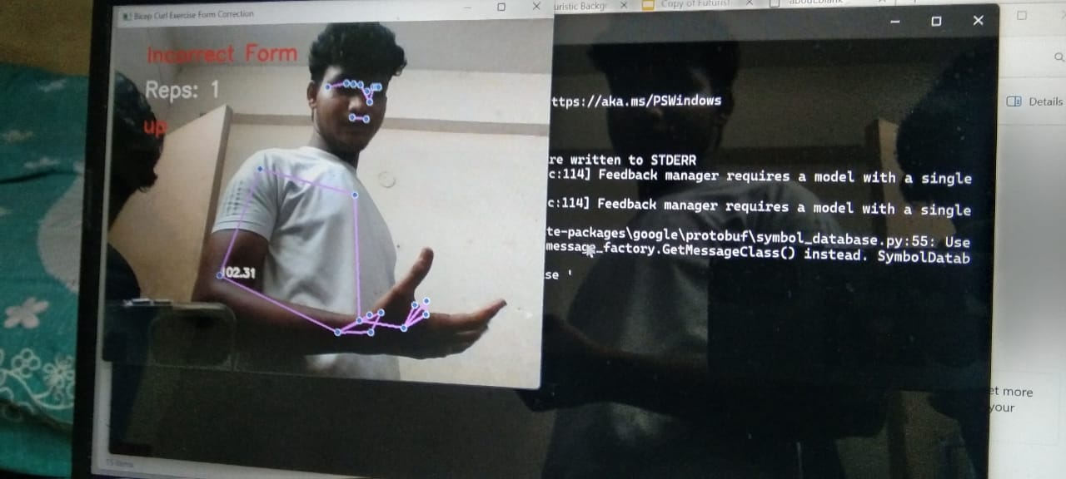
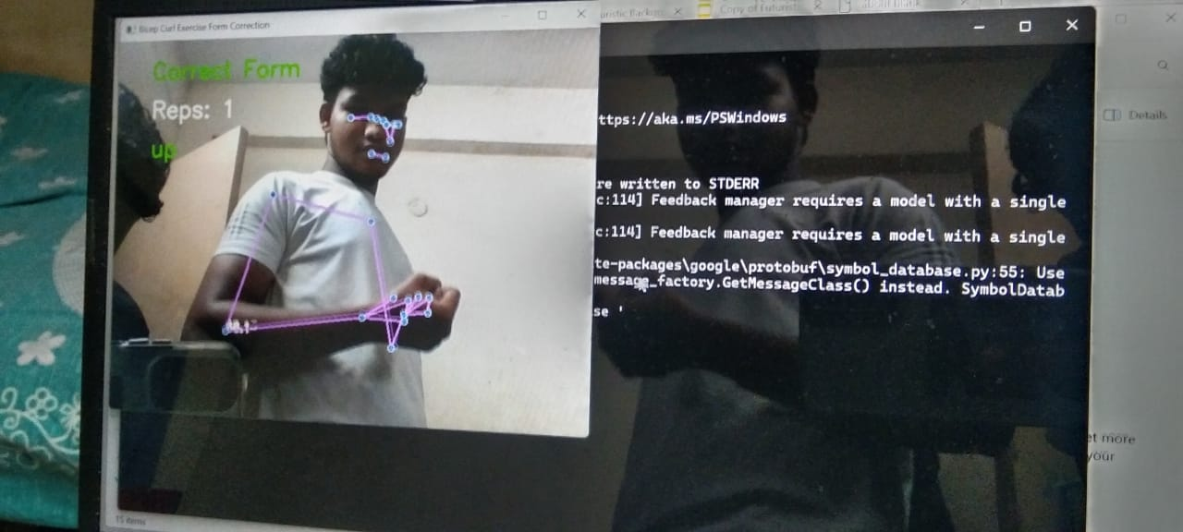
SCREENSHOTS OF OUTPUT

Slide 10

RESULTS AND DISCUSSIONS
The system accurately detects and corrects form for a variety of exercises like bicep curls and shoulder presses.
Real-time feedback helps users adjust their form immediately, leading to better workout efficiency and reduced injury risk.
The voice assistant enhances the user experience by providing hands-free guidance.
System limitations include variability in lighting and camera positioning, which can affect pose detection.

Slide 11
REFERENCES
MediaPipe documentation: https://google.github.io/mediapipe/solutions/pose
OpenCV documentation: https://opencv.org/
Streamlit documentation: https://streamlit.io/
Research papers on exercise form correction using computer vision.

Slide 12
THANK YOU

